Slide 1
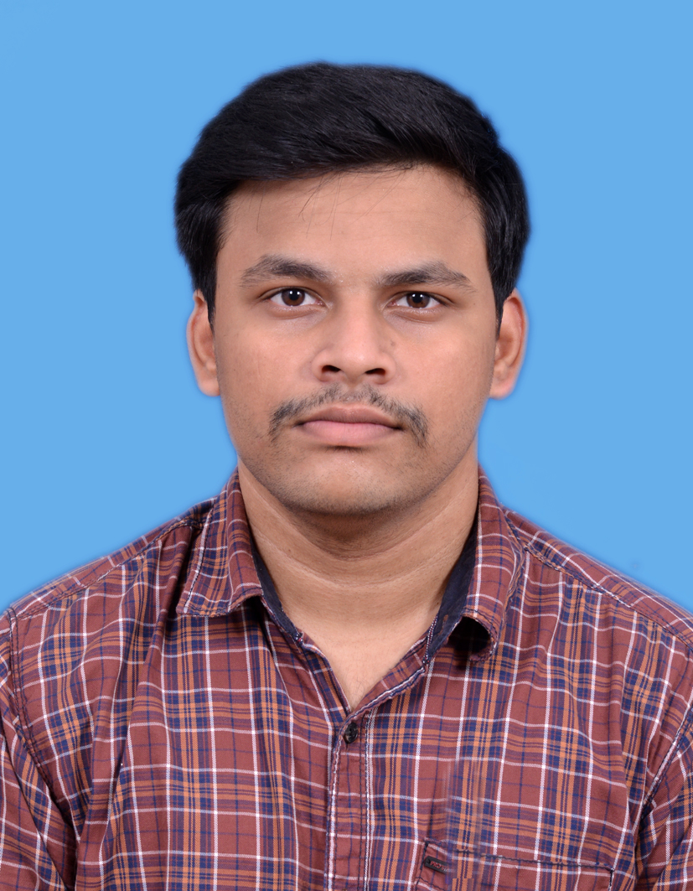


U. K. Kamalesh
Analyst/Software Engineer
Bachelor of Technology
Electronics and Communication Engineering: 2018 - 2022
Skills Java 8 /J2EE
Spring MVC
Spring Security
JPA CRUD
Bootstrap
MERN Stack
ReactJS
NodeJS
MongoDB
Database
SQL database – Oracle, MySQL
No SQL database – MongoDB
Web Technologies
HTML5
CSS3
JavaScript
Add-Ons
GitHub
Maven
Postman
Additional Details
Leadership
Excellent Communication Skills
Team management
Bangalore
kamalesh-u.k@capgemini.com
+91 8248850474
A4
Full Stack Developer having a good knowledge in building an application using Spring Boot with Spring Cloud Microservices architecture.
Has working knowledge on Spring Boot, Spring Security, Eureka Server, Unit Testing, ReactJS.
Ready to learn new technologies and put them to practical use to further improve knowledge on them.
Eager to work in a team of highly dedicated and skilled people and be an important resource to the team in developing and enhancing the project.
Cropdeal Application:
Created a web application named CropDeal to help farmers in upgrading their method of selling crops directly to the Dealer/Seller or to the Customer itself and removing the role of a middleman altogether from the eqaution.
I used SpringBoot Microservice Architecture along with MongoDB for Database, JWT Authentication for Security and ReactJS for Reactive and Interactive website experience.
https://github.com/KamaleshKannan

